Slide 1
Data Abstraction in Python
DVT101 – Lecture 39
- By Dataverse Tutorials

Slide 2
What is Data Abstraction?
Meaning of abstraction in OOP
Hiding complexity, showing essentials
Interface vs implementation
Why abstraction is critical in large systems

Slide 3
Why Do We Need Abstraction?
Simplifies complex systems
Improves security by hiding internals
Reduces dependency between modules
Makes code scalable and maintainable

Slide 4
Real Life Analogy of Abstraction
Software features visible to users
Internal logic hidden from users
Consistent actions across different objects
Different internal behavior, same interface

Slide 5
Abstraction in Object-Oriented Design
Relationship with encapsulation
Role in software architecture
How abstraction supports polymorphism
Blueprint-driven design

Slide 6
What is an Abstract Base Class (ABC)?
Definition of ABC
Blueprint for subclasses
Cannot be instantiated
Forces method implementation

Slide 7
Role of abc Module
Why Python needs abc
How abc enforces structure
abstractmethod decorator purpose
Prevents incomplete class usage

Slide 8
Abstract Method (Concept)
Method without implementation
Acts as a placeholder
Enforces consistency
Child must define behavior

Slide 9
Concrete Method in Abstract Class
Fully implemented method
Reusable logic
Shared across subclasses
Reduces duplication

Slide 10
Abstract Properties
Property-based abstraction
Enforced data attributes
Hidden internal representation
Read-only or computed data

Slide 11
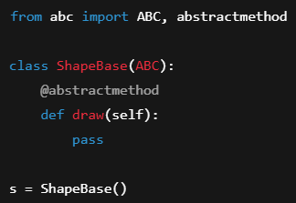
Abstract Class Instantiation Rules
Why abstract classes cannot be created
Type safety enforcement
Runtime error concept
Only concrete subclasses allowed

Slide 12
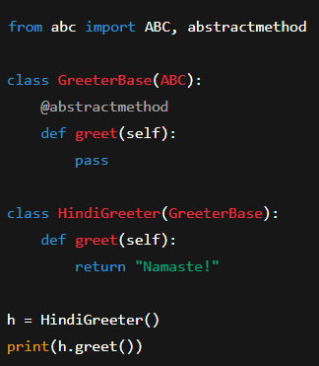
Program Concept: Simple ABC Example
Parent abstract class idea
Child implementing required method
How user interacts with child
Structure fixed, behavior flexible

Slide 13
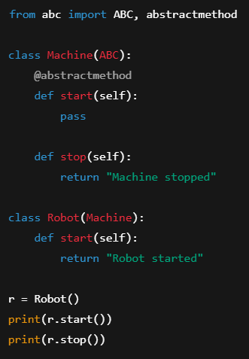
Program Concept: Abstract vs Concrete
Difference between abstract and concrete methods
Shared behavior logic
Enforced customization
Partial implementation design

Slide 14
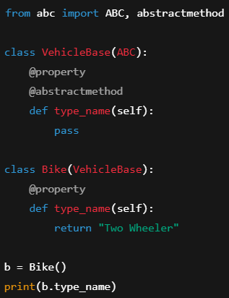
Program Concept: Abstract Properties
Property enforcement through abstraction
Parent defines structure
Child defines actual value
Controlled data exposure

Slide 15
Industry Use Cases
Graphics systems
Payment gateways
Machine learning pipelines
Plugin-based architectures

Slide 16
Summary & Key Takeaways
Abstraction hides complexity
Enforces design contracts
Supports scalability
Essential for enterprise systems

Slide 17


